Slide 1
Performance Testing Basics
Chapter 1

Slide 2
What is Performance Testing
A way of measuring the performance of software
Emulates end user activity on an application
Part of quality assurance in non functional testing (NFT)

Slide 3
Why to do
Better customer satisfaction
Healthy for businesses and their revenue
Save hardware cost (optimal performance from a hardware)
Future planning accordingly to business growth

Slide 4
Real Life Performance Problems
RBS fined £56m for IT breakdown
6.5 million customers at Royal Bank of Scotland, NatWest and Ulster Bank affected by computer meltdown in June and July 2012
Barclays Bank and Euroclear have refused to give details of the technical breakdown that forced the bank to borrow from the Bank of England's emergency reserves this week to cover a shortfall in its finances.
Flipkart fumbles on the big day as server fails
Why Google Search is Faster than your own computer?

Slide 5
What is Performance Engineering
It is a discipline that involves systematic practices, techniques, and activities during each phase of software development lifecycle (SDLC) to meet performance requirements.
It strives to build performance standards by focusing on the architecture, design, and implementation choices.
Things to do
Understand architecture
Identify Performance bottlenecks
Identify how to improve the performance or find root cause

Slide 6
What to measure
Response time of end user steps (transaction response time or even workflow response time)
Total volume of business flows (throughput i.e. transactions per sec or per hour etc.)
Reliability check, Success rate or failure rate (passed and failed transactions)
Maximum supported users\data volume (capacity of application)

Slide 7
Performance Depends on
Response time of a 3 tier application depends on
Server performance (request processed by server in 3 seconds under 1 user load and 2 minutes under 20 user load)
Network performance in case of internet application (10 mbps bandwidth and 100 milliseconds latency between user and server)
Client rendering e.g. Chrome may load and display images faster than IE for some applications
Mobile performance, battery health in case of mobile apps
Response time depends on
Type of page\request
Type of activity (get or update)
Volume of data
Off course, load on server

Slide 8
How to do
Multiple user load on web based applications (2 or 3 or 4 tier)
Facebook accessed by thousands of users at a time e.g. Facebook accessed by hundreds of thousands of users between 9 PM to 11 PM IST
Single user load but with different volume of data on standalone application
Winzip used to zip\unzip different volume of files e.g. 1 Megabytes, 100 Megabytes, 100 Gigabytes

Slide 9
Where to do
Production mimicking environment or scale down environment
Production has 10 Gigabytes RAM, 12 processors of 2.23 Ghz/sec, 10 Terabytes of Disk space
On stable software or application (unstable application will end in rework of script development and test execution)

Slide 10
Types of Performance Tests
Load Test
To measure application performance under anticipated user load
Optimize hardware utilization and improve performance if possible
Stress Test
To measure maximum capacity of application and hardware
Capacity planning of hardware
Longevity Test
To identify performance issues appearing over longer duration (e.g. 12 or 18 hours)
Spike Test
Measure application performance under sudden rise or fall in user load or volume
Network Test
Measure application performance from different geographic locations and UI

Slide 11
Performance Testing Requirement
Service Level Agreement (SLA)
3 sec response time for get pages and 5 sec for update pages
Peak and Maximum User volume
100 users during peak duration and 1000 users during festival or offers
Type of users
Intranet users or internet user
Concurrent users or Simultaneous users
Throughput or transaction mix
50k transactions per hour and 1k business flows per hour
Hardware and software configurations
Production mimicking environment (10 GB RAM, 4 cores of 2.23 Ghz/sec)
Java 1.7.23, Oracle 10g
Maximum threads: 100, Heap memory: 500 megabytes minimum and 4 gigabytes maximum
End to End Business flows or performance test cases

Slide 12
Performance Testing Tools
Load Generation Tools:
Loadrunner
Jmeter
VSTS
NeoLoad
Monitoring Tools:
Dynatrace
Apdynamics
Sitescope
Perfmon (windows utility)
Profiling Tools:
JProfiler
Visual Studio
ANT Profiler
VisualVM
Network Simulation Tools:
Shunra (taken over by HP)
NS

Slide 13
Performance Testing Phases
Requirement Gathering
Identify SLA
Test Planning
Prepare a test plan
Script Development
Test Execution (Iterative)
Analysis & Reporting
Identify Scope
Identify Schedule
Proof of concept
Tools identification
Identify test environment
Agreement with Developer, DBA, Functional SPOCs
Record a Script
Generalize Scripts
Smoke Test Executions
Execute the tests
Identify performance bottleneck & retest it
Prepare a final report
Suggestions and future planning

Slide 14
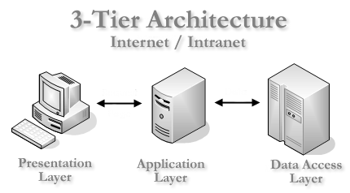


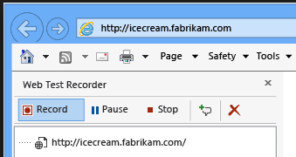
How it works
Scripting

Slide 15
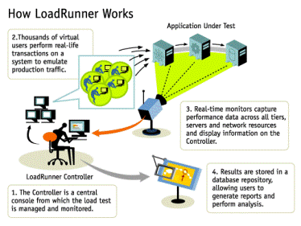
How it works
Testing & Execution

Slide 16
Effort Estimation
Script Development (Steps or complexity) | Efforts (Days)
Small | 1
Medium | 2
Large | 3
Test Execution (Execute and analyze raw results) | Efforts (Days)
Load | 1
Stress | 1
Longevity | 2
Phases | Efforts (weeks)
Requirement Gathering | 1
Accept Scope of Work or Test Plan | 1
Script Development | 2
Test Execution | 1
Report Preparation | 1
Total | 6

Slide 17

Identify Hardware
Evaluate Scalability between Production and Testing HW
RAM
CPU
DISK
NETWORK
Evaluate Software Configurations
Threads
Database connection pool
Heap Memory (Min and Max)
Garbage Collection (settings-interval and policy)
System settings (Hyper threading ON or OFF, Scheduled Backup, Power Saving mode)

Slide 18
Practice
Develop requirement or Scope of document
Develop Performance testing Strategy or test plan
Develop Scripts
Execute Performance Test (Iterative)
Raise, fix and verify defects
Analyze Performance Test results
Develop Summary Report

Slide 19
Performance Testing Review Process
Tests Designed to test Goals identified
Test Strategy
Effort Estimation
Script Review
Test Results Review

Slide 20
Thank You

